Slide 1


House Sales in King County, USA
Predict house price using Machine learning regression models
Liran Ben-Zion
15.08.2019

Slide 2


Motivation: Predict house price using Machine learning regression models
Stages:
Overview of Data
Data preprocessing
Data visualization
Data modeling
Evaluating and summary

Slide 3


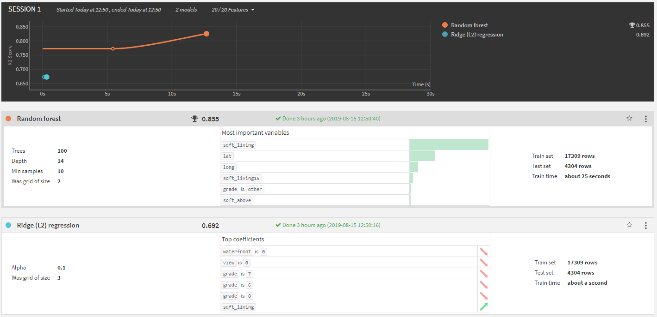
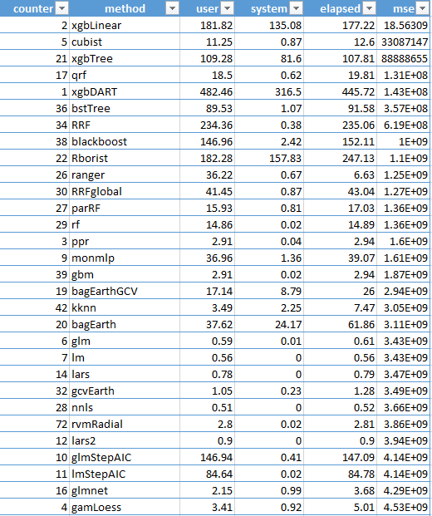
Results- Rstudio vs dataiku
Find the best model for prediction:
Based on all data-80% for train
Based on 300 records
RMSE (XGBoostlinear=145,865)
ROC curve=0.507704

Slide 4


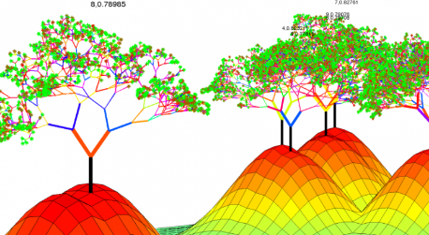
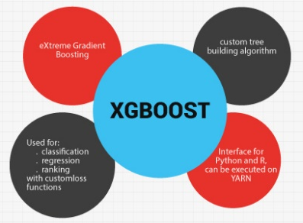
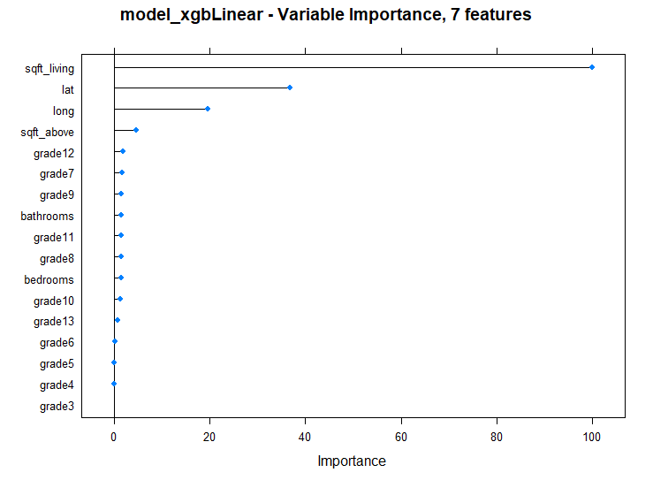
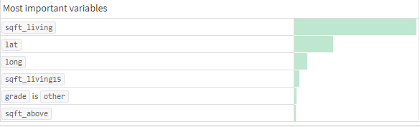
Results- Rstudio vs dataiku
Feature Importance

Slide 5
Insights from using dataiku
The software enables visual processing and analysis in a visual and clear way, without the need for prior programming knowledge
The software allows you to conveniently create graphs and perform data transformations
The software helps prevent coding problems
The software enables monitoring and control of the work process and keeping the work on cloud.
bugs
No graph can be made except for the suggested graphs
In the forecasting process, it is not possible to know which types of ML models exist in the software

Slide 6
Evaluating and summary
Using the software streamlines the workflow, shortens the processing time and allows for more accurate and better forecasting, compared to doing a similar process by programming.
Using the software allows you to draw conclusions quickly, using existing visualizations.
The prediction results show that using the RF model is better than using the model I chose (XGBoostlinear). This can be explained by the fact that I relied on a relatively small initial sample (300 records) whereas the software used all existing data.
The variables selected by the forecasting models were quite similar, indicating that these variables had the greatest effect on the house price.

Slide 7


